Slide 1

Streaming Service Performance Analysis
Growth, Engagement & Strategic Insights
Prepared for: Hero Vired
Created by : Akash Jadhav

Slide 2
Data Anomalies & Logic
Error - 1 | There are 19 Users above where if you see the Join Date & Last Login shows negative value as the Join date can not be higher than the Last login date
Fix - 1 | Hence, I've swapped the last login date and join date to process with report building
Error - 2 | User ID 4115 - You can see the Join Date & Last Login Date shows the same date, however watched hours show as 158 which is not technically possible in the real life as 1 day only have 24 hours.
Fix - 2 | I've updated the Last Login date greater by 1 month from Joined Date to process with report building
Created by : Akash Jadhav

Slide 3
Supported Columns Created
Sr. No. | Column Name | Logic Used
1 | Tenure Days | Last Login - Joined Date
2 | Price Tier | Given Names To Subsciption Prices - Basic - 7.99, Standard - 11.99, & Premium - 15.99
3 | Watch HR per Week | Weekly Watching Hours = Watching hours / (Tenure Days/7)
4 | Frequency Bucket | We have used three type of users "Casual" who watch 0-5 hours watch time in a week, "Regular" who watch 5-15 hours watch time in a week & "Power" who watch 15+ hours watch time in a week.
5 | Per Day Watch Hr | Per Day Watching Hours = Watching Hours / Total number of Movies + Total Number of Series
6 | BR/VW | As We get per day Watch Hour, So have used a logic where if a user is having less than 9 Minutes (0.15 hr) watch time average We've considered it as "Browser" who just comes and check the show and goes back but don't consume the whole content, And second is the "Viewer" who is having more than 9 minutes watch time average Cause that user have spent some time in content consuming.
Created by : Akash Jadhav

Slide 4
1. Subscription & Revenue Analysis
○ Monthly revenue based on different subscription plans
○ Distribution of users across different price tiers
Question : How is our revenue trending over time?
Answer : Revenue is growing steadily month-over-month.
Key Findings:
1. The 'Standard' plan is our most popular subscription tier.
2. There are no major drops in revenue.
3. We are consistently acquiring new users each month.
Created by : Akash Jadhav

Slide 5
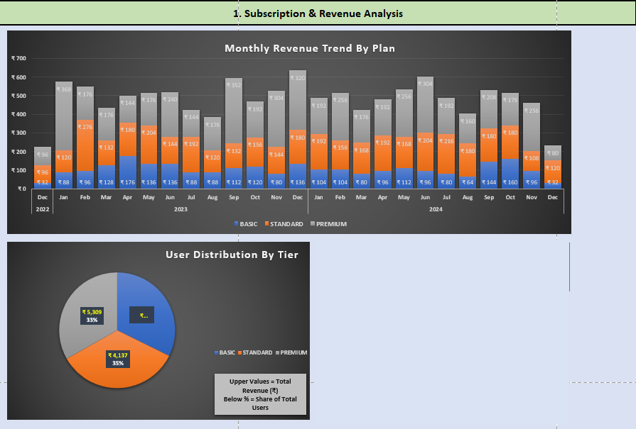
Created by : Akash Jadhav

Slide 6
2. User Engagement Metrics: ○ Average watch hours per user
○ Total movies vs. series watched per user
○ Impact of recommended content on engagement
Question: Who watches what content?
Answer: Movies are the dominant format for everyone, but Youth engagement shows interest in series as well.
Key Findings:
1. Across all age groups, Movies are watched 5x more often than Series.
2. While Movies lead everywhere, the 18-24 Age Group consumes the highest volume of Series (Avg. 110 titles) compared to the 55+ group (Avg. 92 titles).
3. Our core library must remain Movie-focused to satisfy the base, but Series acquisitions should specifically target Younger demographics where adoption is highest.
Created by : Akash Jadhav

Slide 7
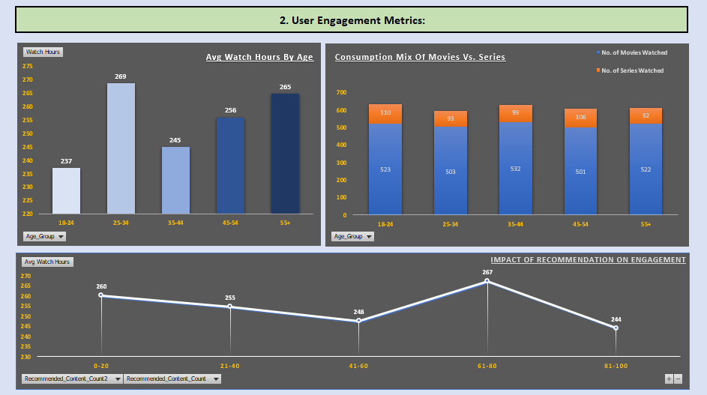
Created by : Akash Jadhav

Slide 8
3. Demographic & Behavioral Insights: ○ Preferred genres by age group.
○ Preferred Genres by Age Group & Device usage trends
○ Peak watch time trends (Morning, Evening, Late Night)
Question: When and how do they watch?
Answer: Evening is the prime time for streaming
Key Findings:
1. The majority of users log in during Evening hours.
2. Sci-Fi and Drama are the top-performing genres overall.
3. Device usage varies by age: Younger users are on Smartphones, while families/older users prefer Smart TVs.
Created by : Akash Jadhav

Slide 9
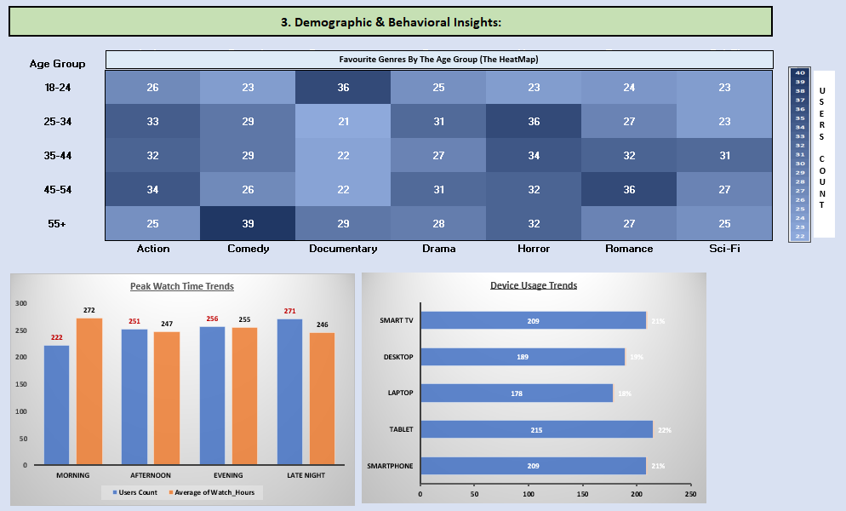
Created by : Akash Jadhav

Slide 10
4. Retention & Loyalty:
○ Membership status (Active vs. Inactive)
○ Loyalty points distribution
○ Frequency of logins and content downloads
Question : Who are our most loyal users?
Answer : Users who 'Download' content stay longer.
Key Findings:
1. Users in the 'Power' frequency bucket have a 55% adoption rate for Downloads, compared to only 46% for Casual users.
2. The "Download" feature is a strong indicator of commitment; users who take content offline are more invested in the ecosystem.
3. Marketing the "Download for Offline" feature to Casual users could be a strategic hook to increase their watch time and move them into the 'Regular' or 'Power' tier.
Created by : Akash Jadhav

Slide 11
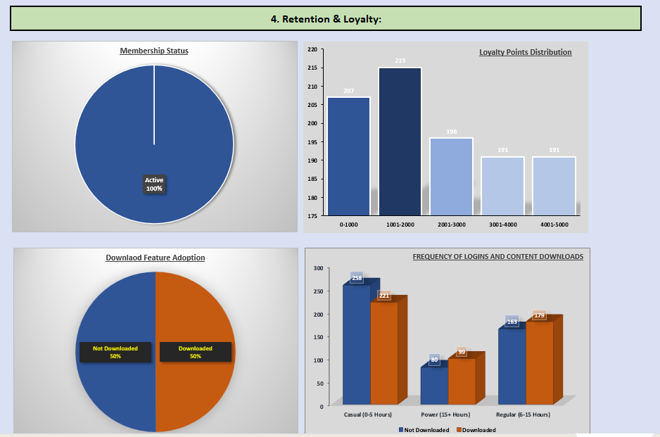
Created by : Akash Jadhav

Slide 12
5. Payment Preferences & Regional Trends:
○ Preferred payment methods by region
○ Subscription trends by country
○ Language preferences and their correlation with engagement
Question: Where are our users located?
Answer : We have a global user base with local preferences.
Key Findings:
1. Payment methods differ significantly by country (e.g., higher Crypto usage in specific regions).
2. Language preferences strongly match the content consumption patterns.
3.Subscription tier preference (Basic vs. Premium) varies by regional wealth.
Created by : Akash Jadhav

Slide 13
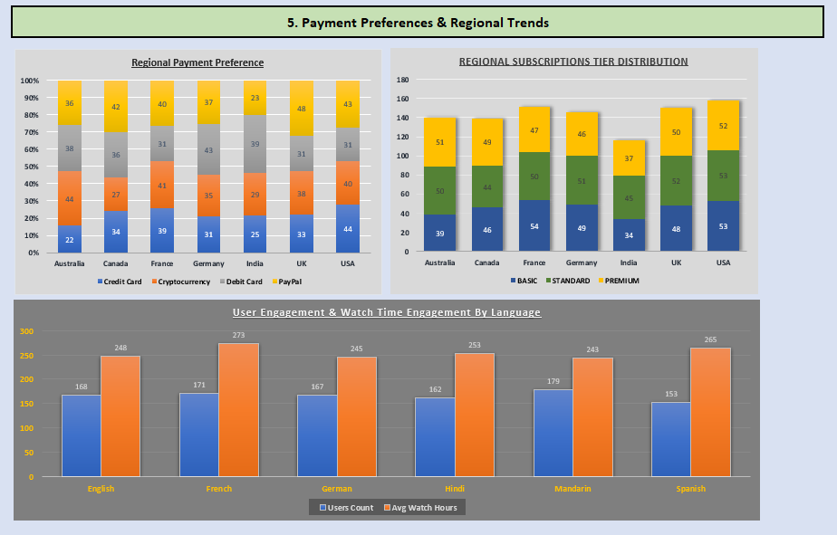
Created by : Akash Jadhav

Slide 14
Thank
You.
Created by : Akash Jadhav

